Slide 1
RAJARAMBAPU INSTITUTE OF TECHNOLOGY,RAJARAMNAGAR.
DEPARTMENT OF COMPUTER SCIENCE & ENGINEERING
Final Year Mega Project Presentation
Design and Develop a Kickstart server configuration
software using Glade UI

Slide 2
INTRODUCTION
1
4
Kickstart
Open source software development
main roll where a system administration is required
2
5
Software Organizations
Glade UI
Many software organizations and developers leading towards open source technology
Glade UI is system configuration toolkit.
3
6
Our Contribution
Kickstart installation method to automatically perform unattended operating system installation and configuration
By considering the importance of this evolution we would like to contribute and introduce ourselves in this area

Slide 3
OBJECTIVES
1. To study system working and understand the different system administration strategies.
2. To learn open source software development strategies.
3. To implement a software which automate system installation.

Slide 4
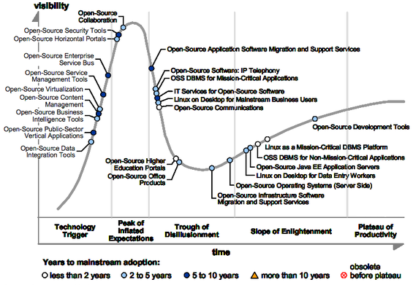

Slide 5
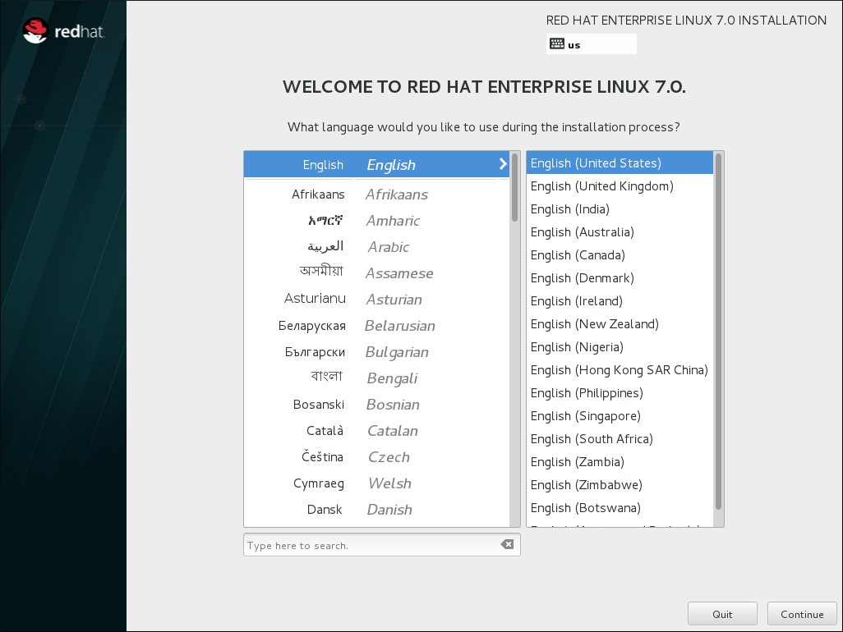
Logic beyond kickstart
# Keyboard layouts
keyboard 'us'
# Halt after installation
halt
# System timezone
timezone Africa/Abidjan
# System language
lang en_US

Slide 6
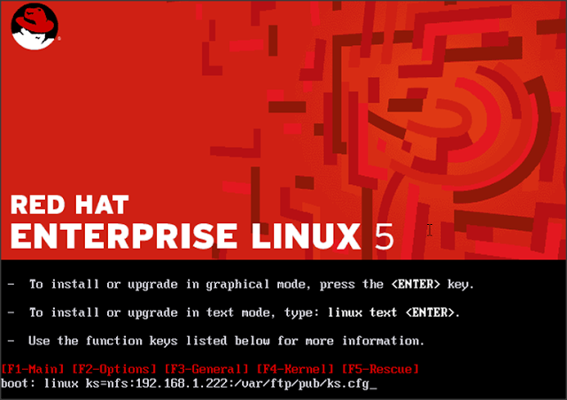
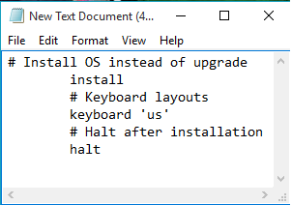
How It Work :
1] Create Kickstart File with extension .cfg
2] Host file on Ftp, Http, NFS Server.
3] Access this file from during installation

Slide 7
Different Ways To Pass Installation Source:
CD-RROM, USB

Slide 8
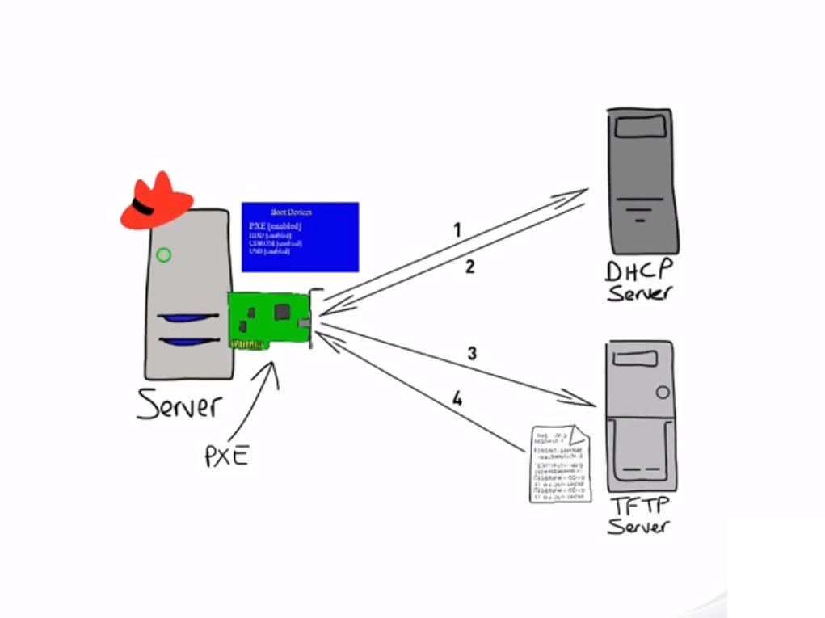
2. NFS, FTP, HTTP, Hard Drive :
PXE (Pre Executable Environment )

Slide 9
Functional Requirements
1. Basic Configuration
Choose of language to use during the installation
Root Password field(encryption)
2. Installation
Method

Slide 10
3. Boot Loader Options

Slide 11
4. Network Configuration

Slide 12
5. Partition Information
Master Boot Records allow to clear or not MBR.
To remove existing partition or preserve it.
create partition like /, /boot, /home, /var, /temp, /usr
With filesystem of type ext2, ext3, ext4, swap, vfat, xfs.

Slide 13
Firewall Configuration :

Slide 14
Pre-Script Configuration :
User can add commands after the kickstart file has been parsed and before the installation begins.
It can be possible through already configured network.
To include a pre installation script pass script to this field.
Post-Installation Script :
User can add commands to execute on the system after the installation is completed.
It can be possible through already configured network.
the script include commands to access resources on the network.

Slide 16
Performance Requirements :
Fast Start-up
Software Responses
Functionality Responses
Performance Analysis Functionality
Output Configuration file
Safety and Security Requirements :
Encryption Standards - MD5 hashes-salt mechanism

Slide 17
Product Functionality
Fig: Use Case Showing Major functionality of the Product

Slide 18
Basic Configuration
1
Language, Keyboard, Time Zone, Root Password
Method / loader
2
New / Upgrade / Source :CD-ROM,NFS,FTP,HTTP.
Grub, Grub Password
Partition
3
OS INSTALATION
Number of Partition Required.
Network / Package
4
License.
GUI and other packages.

Slide 19
Brief Overview
Profiles
Standard Profile
Basic
Network lab
Database lab
Programming lab (Python, Java, Perl, C ..etc.)
Save Profile
System Configuration
Language, Keyboard, Time Zone, Root Password
Installation Method
Boot loader option
Disk Partition
Network configuration
Effect of Installation
System Performance
Dependent Packages
Automation
Pre-Script
Task during Installation
Post-Script
Task After installation

Slide 20
DFD
Fig: DFD Level 0 (Showing Overall Product Working).

Slide 21
DFD Level 1:
Fig: DFD Level 1 (Showing Each Module Working).

Slide 22
DFD Level 2:
Fig: DFD Level 2 (showing each functional module in software product as well as their sub-modules).

Slide 23
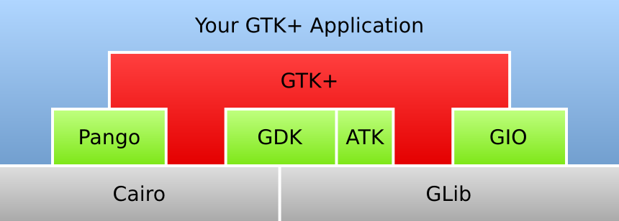
Users and Characteristics
A system user:
Technical
Using functionality with knowing meaning.
Non-Technical
Just related to functionality.
Operating Environment
Minimum Requirements
1 GB RAM
32 bit Processor
Required Software
Python 2.5 or later version
GTK+ 3 Libraries

Slide 24
Design and Implementation Constraints
Python Crash
GTK+ Libraries Problem
Shell Command Variations
Repository Variation
Performance Analysis module
User Documentation
Standalone support or local support.
Online Support.
Assumptions and Dependencies
Network Configuration
The host system is accessible from target system.
Target system architecture
Configuration specified in the configuration file.
Network speed
Minimum speed of 100 mbps.
Repo configuration
On host system or other system for fast access.

Slide 25





PRODUCTS AND ADDITION
Cobbler
Automated tool by Red Hat for process configurations.
Cobbler with JOOMLA
Enhanced version with browser supportability.
PyKickstart
Python library used for reading and writing kickstart files.
Security Enhancement
Additional encryption methods and algorithms.
Additional Timeliness
Time complexity prediction.

Slide 26
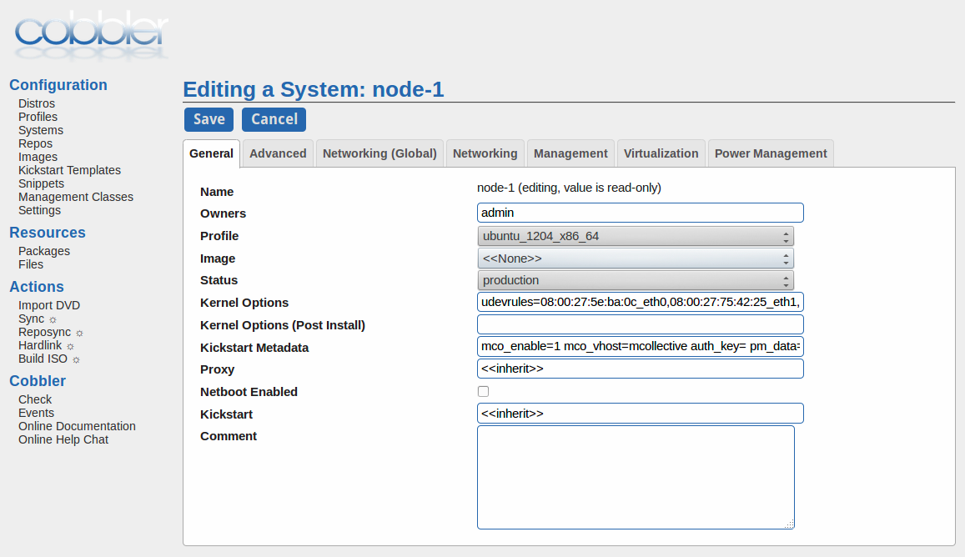
Cobbler
Automated tool by Red Hat for process configurations.
Server Script Installation
DHCP/BOOTP Installation
NFS, NFS Kerberos Installation
DNS Installation

Slide 28
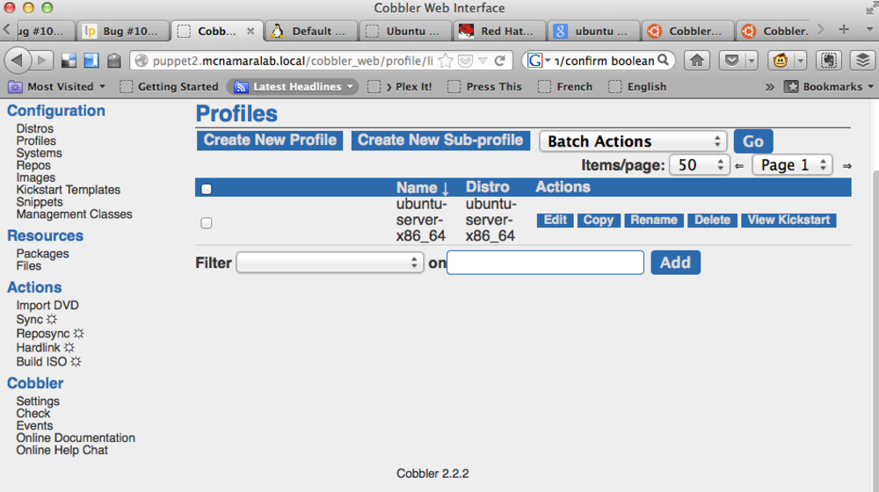
Cobbler with JOOMLA
Enhanced version with browser supportability.
Server Script Installation
DHCP/BOOTP Installation
NFS, NFS Kerberos Installation
DNS Installation

Slide 30
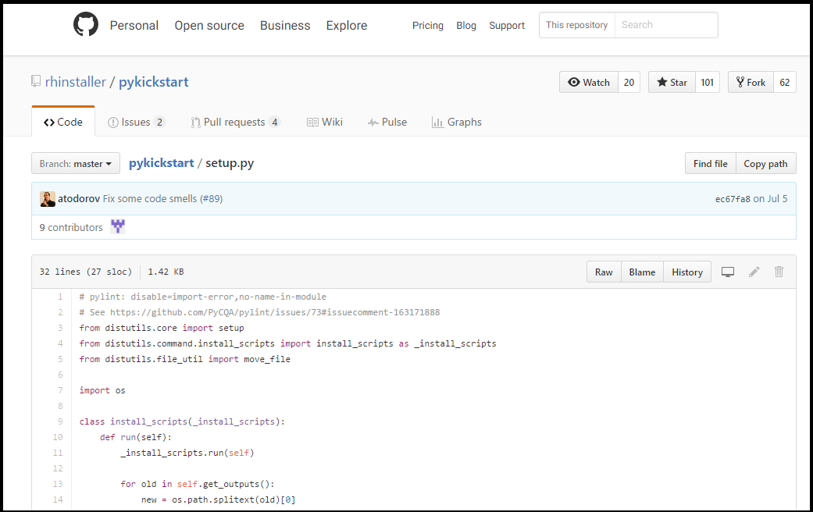
PyKickstart
Python library used for reading and writing kickstart files
Common data representation
Synchronize kickstart support between Anaconda and system-config-kickstart
Supports for YUM platform

Slide 31
Security Enhancement
Message Digest algorithm 5
MD5
MD5 algorithm is a widely used hash function producing a 128-bit hash value. This hash is possible to crack by Straight brute forcing method.
Secure Hash Algorithm-2
Powerfull cryptographic hash function of 256-bit.
Difficult to crack.
SHA-256
Secure Hash Algorithm-1
SHA-1
SHA-1 is cryptographic hash function designed by the NSA and published by NIST.
Suffer from extensive vulnerabilities like collision attack

Slide 32
6 LAYERS
LAYER 6
LAYER 6
Deployment GUI on server
LAYER 5
LAYER 5
Furnishing functionalities with Glade UI
LAYER 4
LAYER 4
Security Enhancement in
authentication credentials
LAYER 3
LAYER 3
Implementation Setup
LAYER 2
LAYER 2
Automatic Installation
LAYER 1
Basic installation Commands
LAYER 1

Slide 33
THANK YOU!
Under Guidance of,
Prof. S.R. Poojara
Presented by,
Paratmandali Ajay Pandurang 1303057
Rathod Ajay Santram 1303025
Ghute Ankit Anil 1303053
Tale Yadnyawalkya Vitthal 1303052
Kulat Akshay Vitthal 1303054

